Slide 1
Data Mining and Data Warehousing
Unit 2
Introduction to Data Mining

Slide 2
Why Data Mining? (Motivation)
The Explosive Growth of Data: from terabytes to petabytes
We are drowning in data, but starving for knowledge
“Necessity is the mother of invention”—Data mining—Automated analysis of massive data sets

Slide 3
What is Data Mining?
The process of Discovering meaningful patterns & trends often previously unknown, from large amount of data, using pattern recognition, statistical and mathematical techniques

Slide 4
Why Data Mining?—Potential Applications
Data analysis and decision support
Market analysis and management
Market basket analysis, sale techniques, customer feedback on items (Opinion Mining)
Risk analysis and management
Forecasting, decision support system
Fraud detection and detection of unusual patterns (outliers)
Other Applications
Text mining (news group, email, documents) and Web mining
Stream data mining (mining from continuous / rapid data
Eg Telephone communication pattern, Web Searching, Sensor data
Bioinformatics and bio-data analysis

Slide 5
Knowledge Discovery (KDD) Process
Knowledge
Data mining—core of knowledge discovery process
Pattern Evaluation
Data Mining
Task-relevant Data
Data Warehouse
Selection
Data Cleaning
Data Integration
Databases

Slide 6
Data Mining Functionalities
Multidimensional data concept
Association analysis on frequent patterns
Classification and prediction
Cluster analysis
Outlier analysis
Outlier is an unusual behavior, i.e. Data object that does not comply with the general behavior of the data
Useful in fraud detection, rare events analysis
Trend and evolution analysis

Slide 7
Are All the “Discovered” Patterns Interesting?
Data mining may generate thousands of patterns: Not all of them are interesting
Suggested approach: Human-centered, query-based, focused mining
A pattern is interesting if it is easily understood by humans, valid on new or test data with some degree of certainty, potentially useful, novel, or validates some hypothesis that a user seeks to confirm

Slide 8
Issues in Data Mining
Mining methodology
Mining different kinds of knowledge from diverse data types, e.g., bio, stream, Web
Performance: efficiency, effectiveness, and scalability
Pattern evaluation: the interestingness problem
Handling noise and incomplete data
Parallel, distributed and incremental mining methods
Integration of the discovered knowledge with existing one: knowledge fusion
User interaction
Data mining query languages and ad-hoc mining
Expression and visualization of data mining results
Interactive mining of knowledge at multiple levels of abstraction
Applications and social impacts
Domain-specific data mining & invisible data mining
Protection of data security, integrity, and privacy

Slide 9
Data Objects and Attribute Types
Nominal Attribute
Binary Attribute
Ordinal Attribute
Numeric Attribute
Interval Scaled Attribute
Ratio Scaled Attribute
Discrete VS Continuous Data

Slide 10
Nominal Attributes
Symbols or Name of things
Each value represent some value of category
Enumerations
Eg hair color, marital status

Slide 11
Binary Attributes
With only two categories (state 0 or 1)
True / False, Present / Absence
Eg Patient Smokes, Testing Result (+ve / -ve)
Binary attribute is symmetric if both of its states are equally valuable (i.e. no preference on which outcome should be coded as 0 or 1 like gender)
Binary Attribute is asymmetric if the outcomes of the states are not equally important eg HIV test, Corona test)

Slide 12
Ordinal Attributes
Attribute with possible values that have a meaningful order or ranking among them
Eg Drinking (Small, Medium, Large)
Lecturer, Asst. Professor, Professor
Strongly Agree, Agree, Disagree

Slide 13
Numeric Attributes
Quantitative
Interval Scaled Attribute
Measured on a scale of equal size units
Eg Calendar Date (2002 and 2010 are 8 years apart)
Ratio Scaled Attribute
If a measurement is ratio scaled means a value being multiple (or ratio) of another value
Eg Frequency of words in a document

Slide 14
Discrete VS Continuous Attributes
A discrete attribute has a finite or infinite set of values which may or may not be represented as integer (Eg Age)
If attribute is not discrete then it is continuous (Eg temperature )

Slide 15
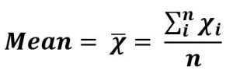
Statistical Description of Data
Mean
Arithmetic mean
Trimmed mean
Arithmetic mean is influenced by the outliers
Calculated by dropping a fixed number of sorted values from each end of the sequence of data given and then calculated the mean (average) of remaining values
Eg
{0,2,1,3}, trimmed value = 25%
The first 25% and last 25% are discarded and take the mean of remaining
i.e. {0} and {3} are discarded and mean = (2+1)/2 = 1.5
Weighted mean
Median and Mode

Slide 16
Measuring the Dispersion of Data
Degree to which numerical data tend to spread (variance of the data)
Most common methods to measure the data dispersion
Range
The five number summary (based on quartile)
The inter quartile range
Standard deviation

Slide 17

Measuring the Dispersion of Data…
Range
Difference between largest and smallest value
Quartile
The k^{th} percentile of a set of data in numerical order is the value x_{i} having the property that k percent of the data entries lie at or below x_{i}
First quartile (Q₁) is the 25th percentile
Median is 50th percentile
Third quartile (Q₃) is 75th percentile
Example

Slide 18
Measuring the Dispersion of Data…
Inter Quartile Range
IQR = Q₃ – Q₁
Outlier
usually, a value higher/lower than 1.5 x IQR
Five Number Summary
Shape of distribution can be obtained by Minimum, Q₁, Median, Q₃, Maximum

Slide 19
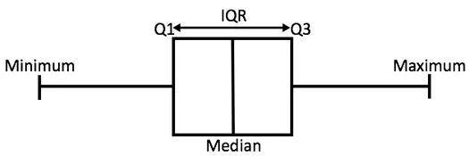
Measuring the Dispersion of Data…
Boxplots
Way of visualizing the distribution
Incorporate five number summary as follows
Ends of the boxes are quartiles (i.e. the length of box is IQR)
Median is marked by a line within the box
Two lines (called whiskers) outside the box extend to the MINIMUM and
MAXIMUM
Represented as

Slide 20
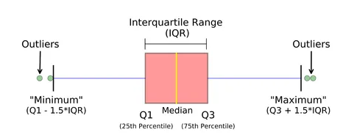
Measuring the Dispersion of Data…
Boxplots…
Boxplots are useful as they show outliers within a data set
When reviewing a boxplot, an outlier is defined as data point that is located outside the whiskers of the bokplot

Slide 21
End of Session

